Slide 1
Preliminary Prioritised List of Proposed New Services
WP2 team at BGCI

Slide 2
Potential new services
Long list compiled from various sources:
  15 items in the Description of Work
  Additional suggestions from Uri – 11
  Suggestions from Thierry – 13
  Alex’s Tweets – 3
  WP3 Workshop September 2009 – 10
  Richard White – 2
  Andrew Jones – 19
  Gregor Hagedorn – 1
  Total = 74 with brief description for further discussion by Services Team

Slide 3
Methodology: Questionnaire
Questionnaire to find out about users and their priorities
  Published on BGCI website (20 October 2009)
  Published on 4D4Life website (22 October 2009)
  GPCC members (c. 40, 27 October 2009)
  Bionet regional partnerships (LOOPs) (27, October)
  Promoted via Taxacom (c. 1,700) & Conbio mailing lists (23 October 2009)
  Annual Checklist CD-Rom mailing list (c. 500) (27 October 2009)
  TDWG meeting (November 2009)
  Durban Education Congress (November 2009)

Slide 4
Methodology: Questionnaire (contd)
  CBD contacts (c. 300) (19 November 2009)
  Published on 6 LinkedIn commercial related forums (c. 77,000) (19 November 2009)
  Mailout to companies (c. 100) (23 November 2009)
  IUCN SSC e-bulletin (c. 7,000) (November 2009)
  GBIF telephone interview (November 2009)
  Washington, D.C. visit (December 2009)
  Cambridge visit (December 2009)
  244 respondents = 202 complete + 42 incomplete

Slide 5
Questionnaire: Question 21
Rank 5 out of 12 new services
  List based on services in Description of Work
  Completed by 162/202
  Ranked by popularity and user sector
  Top 5 – All user category
    Additional information (e.g. conservation status…
    Thumbnail images of representative or iconic species in the hierarchy
    Range of web services, e.g. synonymy…
    Common names in the taxonomic hierarchy
    Species totals within families and the entire Catalogue

Slide 6
Questionnaire: Question 22
Suggest up to three new services
  Completed by 87/202
  No structure so ‘messy’
  Examples of new services requested:
    Basic information on habitat, ecology, conservation status - where appropriate/known
    Include missing taxon, eg Nematodes
    Thumbnails for each species
    Maps of distribution/last spotted areas
    Greater linkage to other providers for additional information and images
  Grouped using existing services list or new services added, e.g. Images (photographs and drawings)

Slide 7
Priorities from questionnaire
Additional information (e.g. conservation status…
  Include additional information in the CoL, such as conservation status, habitat requirement, and species description.
More complete catalogue, e.g. missing groups…
  CoL should be as complete and comprehensive as possible.
Images (photographs and drawings)
  Use a range of images throughout the CoL, such as drawings or photographs; and whole or parts of the organism.

Slide 8
Priorities from questionnaire (contd)
Distribution maps
  Provide distribution maps showing either shaded country or geographical region or point location.
Link to other sources of information
  Provide links from the “Species details” page to external sources of information.

Slide 9
Interviews
Interviews with Global Biodiversity Organisations
  Key priorities suggested:
    Ensure dynamic checklist works (EOL)
    Feedback mechanism allowing data interchange and review – suppliers (GBIF)
    Include competing taxonomies (BOL)
    Additional information (WWF US)
    Transparency and justification (IUCN, Birdlife)

Slide 10
David Remsen, GBIF
  Publishes biodiversity data; approximately 190m distinct scientific names with some higher taxonomic detail
  Promotes data standards
  Uses CoL as a framework for the data: taxonomic backbone; synonymy; and common names

Slide 11
Martin Sneary, BirdLife International
  Compiled their own global bird taxonomic treaty
  Believes their approach is transparent and open to external scrutiny
  Suggested better indicator of completeness

Slide 12
Colby Loucks, WWF US
  Developed their own checklists for mammals, birds, etc
  May use CoL when reviewing or compiling checklists
  Would like additional information, such as distribution and conservation status

Slide 13
Scott Federhen, NCBI
  Has several databases, such as Genbank (genetic sequence data) and Pubmed (biomedical publications)
  Developed their own taxonomic classification for these systems
  Finds CoL useful because it’s big and is a compilation of several sources
  Sometimes access GSDs directly as they are updated more frequently

Slide 14
Jim Edwards, EOL
  Frustrated by the Dynamic Checklist not working properly
  Suggested CoL provide a mechanism for taxonomic feedback from EOL users to GSDs
  Greater sharing of data between CoL and EOL, e.g. use EOL web services to provide images

Slide 15
Craig Hilton-Taylor, IUCN
  Every species on the red list has a link to CoL
  Red list is not a definitive taxonomic resource, e.g. limited synonymy
  Justification for the taxonomic representation and explanation of how GSD data incorporated into CoL

Slide 16
The array of potential services
GBIF
EOL
GNA
EOL
Incoming services
Images
Data integrators
Outgoing links
GSD1
Standard dataset
AC on website
AC web services
Global checklist
Global hub
Wrapper
AC on CD-Rom
GSDN
Wrapper
DC on website
DC web services
Support services for global hub
Comparison and harvesting tools
Nomenclator name alert services
Web-based facilities for end-users
Web Services
Support services for regional hubs
Feedback mechanism
Regional checklist
RSD1
RSD1
Information repository
Regional checklist
Regional hub 1
Regional hub 2
Regional checklist
RSDN
RSDN

Slide 17
Prioritised List of Services
    Functionality of dynamic checklist (EOL)
    Feedback mechanism allowing data interchange and review – suppliers (GBIF)
    Transparency of process and justification (IUCN, Birdlife)
    Include parallel taxonomies (BOL)
    More complete catalogue, e.g. missing groups…
    Additional information (e.g. conservation status…
    Images (photographs and drawings)
    Distribution maps
    Link to other sources of information

Slide 18
Further Steps
Services Team meeting – discussion of full list of proposed new services & review of prioritisation
Follow – up with 151 questionnaire respondents seeking their views on prioritised services from user survey
Interviews with TRAFFIC and UNEP-WCMC
Engage more fully with the corporate sector - small workshops
Develop communications strategy for Catalogue of Life more fully to address lack of awareness across sectors and promote anticipated new services

Slide 19
Developing a communications strategy
The Catalogue of Life is a good concept, however, it needs to broaden its horizons or be swallowed up by the likes of Wikipedia etc. needs a marketing, design edge to make it more user friendly (P-pod.co.uk, commercial image library)
From your email description it looks really good and I will check it out now that I'm aware of it. When I've searched recently on species names it hasn't come up on google so maybe you need to look into getting its search tags improved?

Slide 20
Developing a communications strategy
Develop a much more attractive and informative starting page for the Catalogue of Live. The present starting page does not even give a glimpse about what wonderful tools are hidden behind. (University of Hamburg)

Slide 21
Definition and common understanding
The Catalogue of Life is the most comprehensive and authoritative global index of species currently available. It consists of a single integrated species checklist and taxonomic hierarchy. The Catalogue holds essential information on the names, relationships and distributions of 1.25 million species, about 66% of all known plants, animals, fungi and micro-organisms. This figure continues to rise as information is compiled from diverse sources around the world.

Slide 22
Tools and resources
CoL Website
E-bulletin – mailing list 550 – at least 1000 by end of year
4D4Life workshops
Press releases
Articles and features
Attendance at conferences and meetings
LEAFLET
Exhibition panels
Posters
CENTRAL REPOSITORY – Reading University - MONITORING

Slide 23

Different approach for different sectors
Initial targets:
Academic
Commercial
Governments – strong presence at CBD SBSTTA & COP

Slide 24


Slide 25
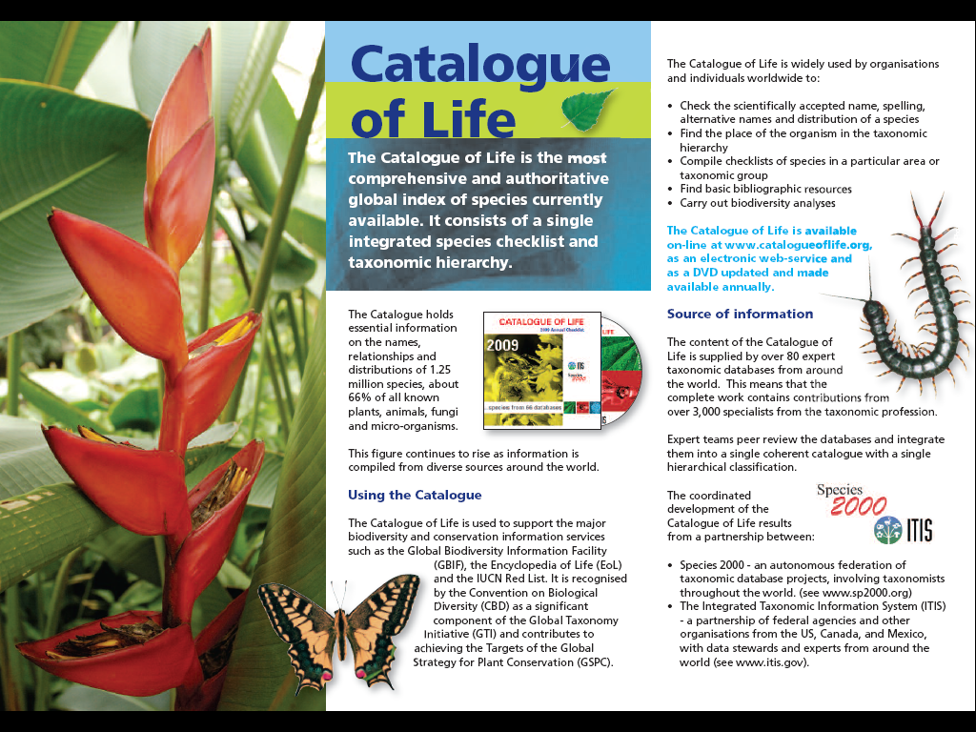

Slide 26


Help us to promote CoL!
YOUR IDEAS ARE MOST WELCOME
THANK YOU

